Slide 1
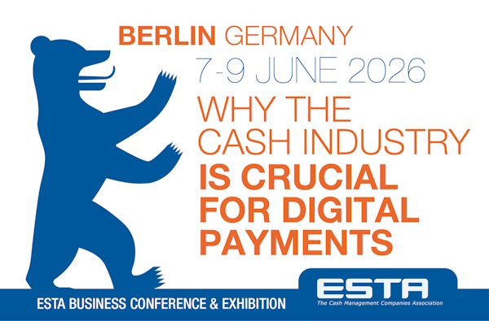
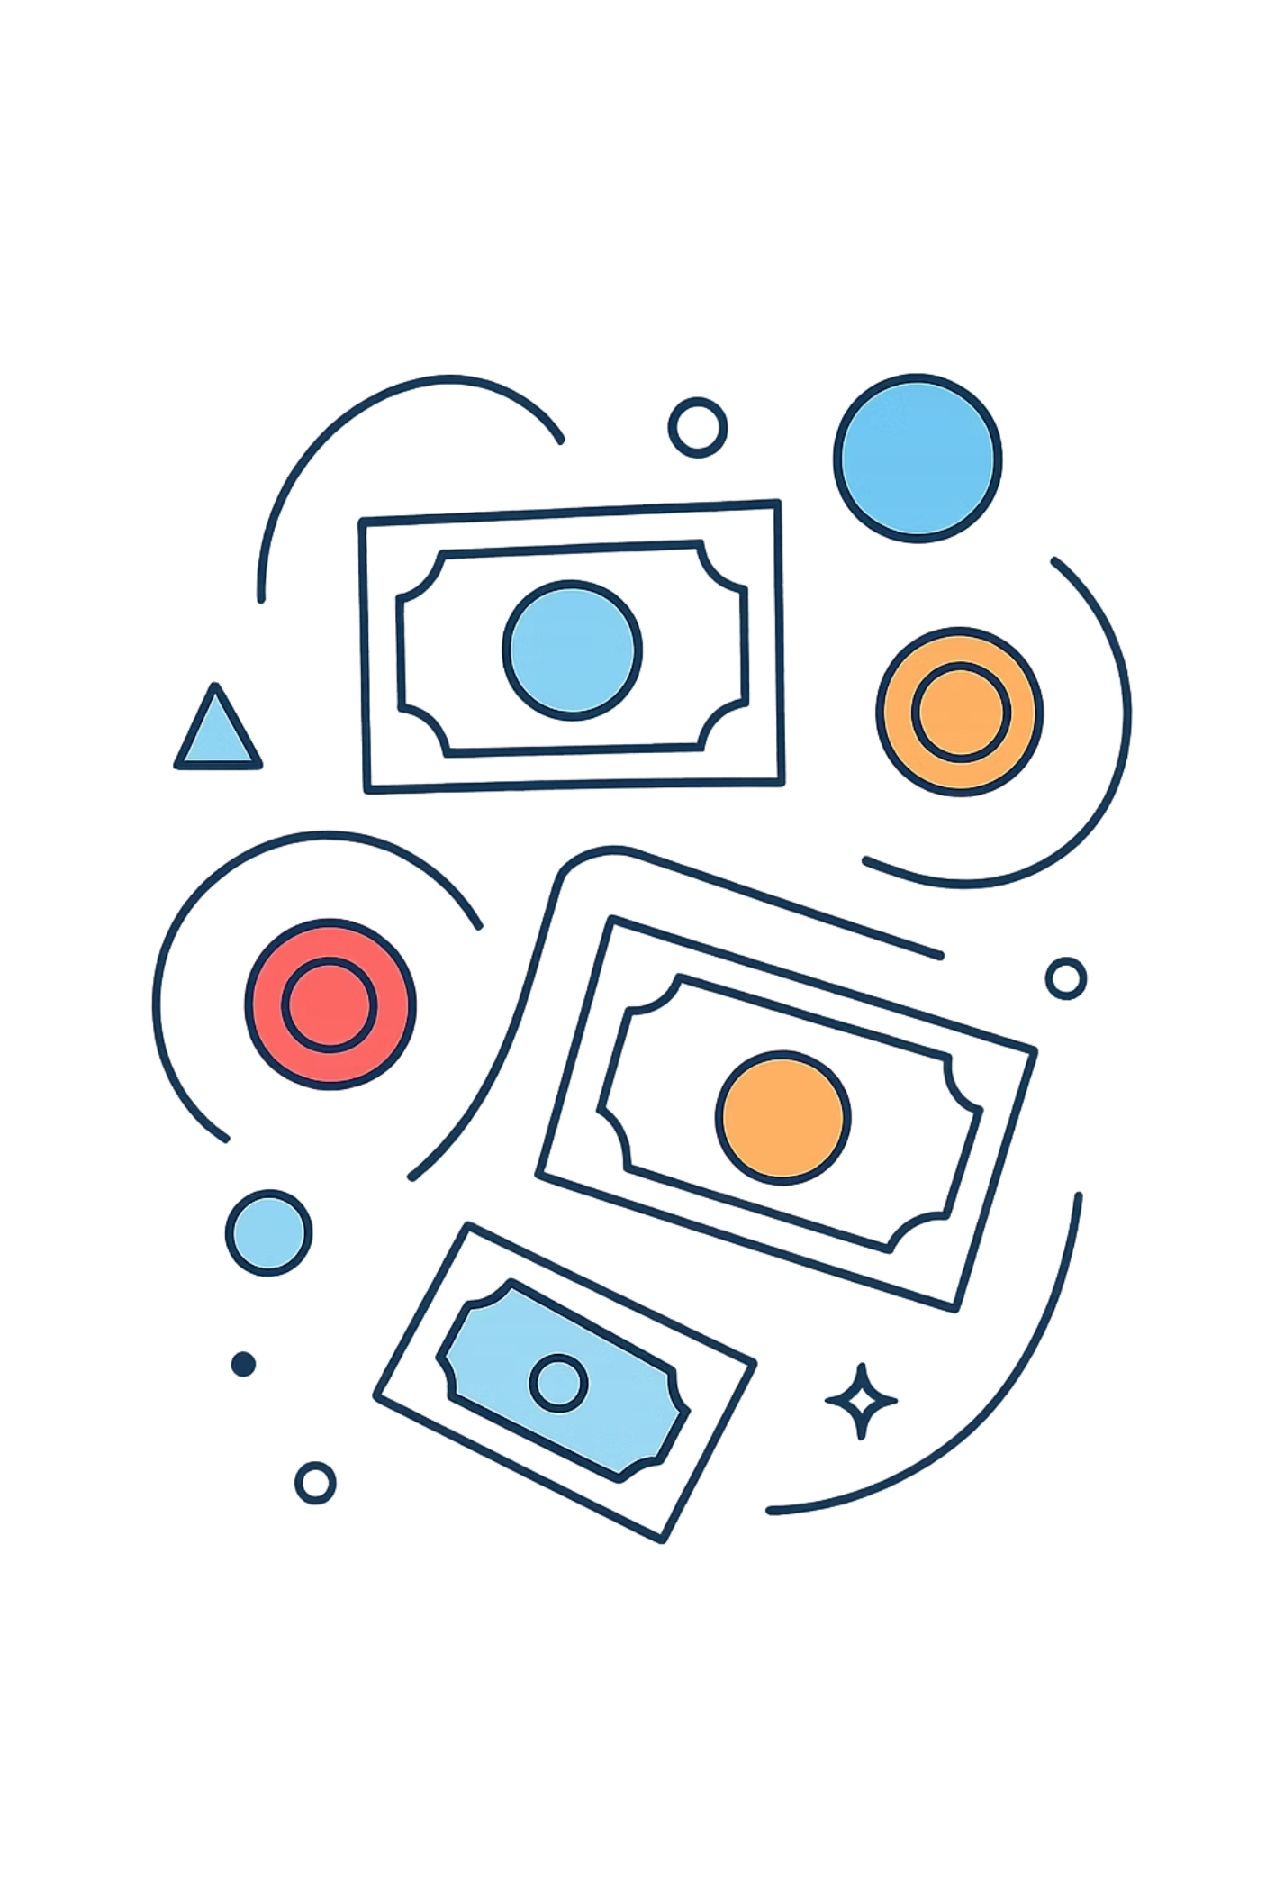
ESTA · BERLIN · 8 JUNE 2026
A Theory of Cash in the 21ˢᵗ Century
The last form of money that belongs to citizens, not to institutions.
FRANCISCO RODRÍGUEZ FERNÁNDEZ

Slide 2
THE PARADOX OF BANKNOTES
Cash is losing as a flow.
Cash is winning as a stock.
POS Share of Transactions
Euro Banknotes in Circulation
79% → 52%
€220bn → €1.6tn
Euro area, 2016 → 2024. Cash is used less often at the point of sale as digital alternatives proliferate.
Source: ECB SPACE 2024
2002 → 2025 — a sevenfold increase. Citizens hold more physical cash than ever before, even as they use it less for day-to-day transactions.
Source: ECB Annual Accounts 2025
This is not confusion. This is information. Citizens are choosing to hold cash as a store of value and an instrument of resilience, even whilst preferring digital methods for routine payments.

Slide 3
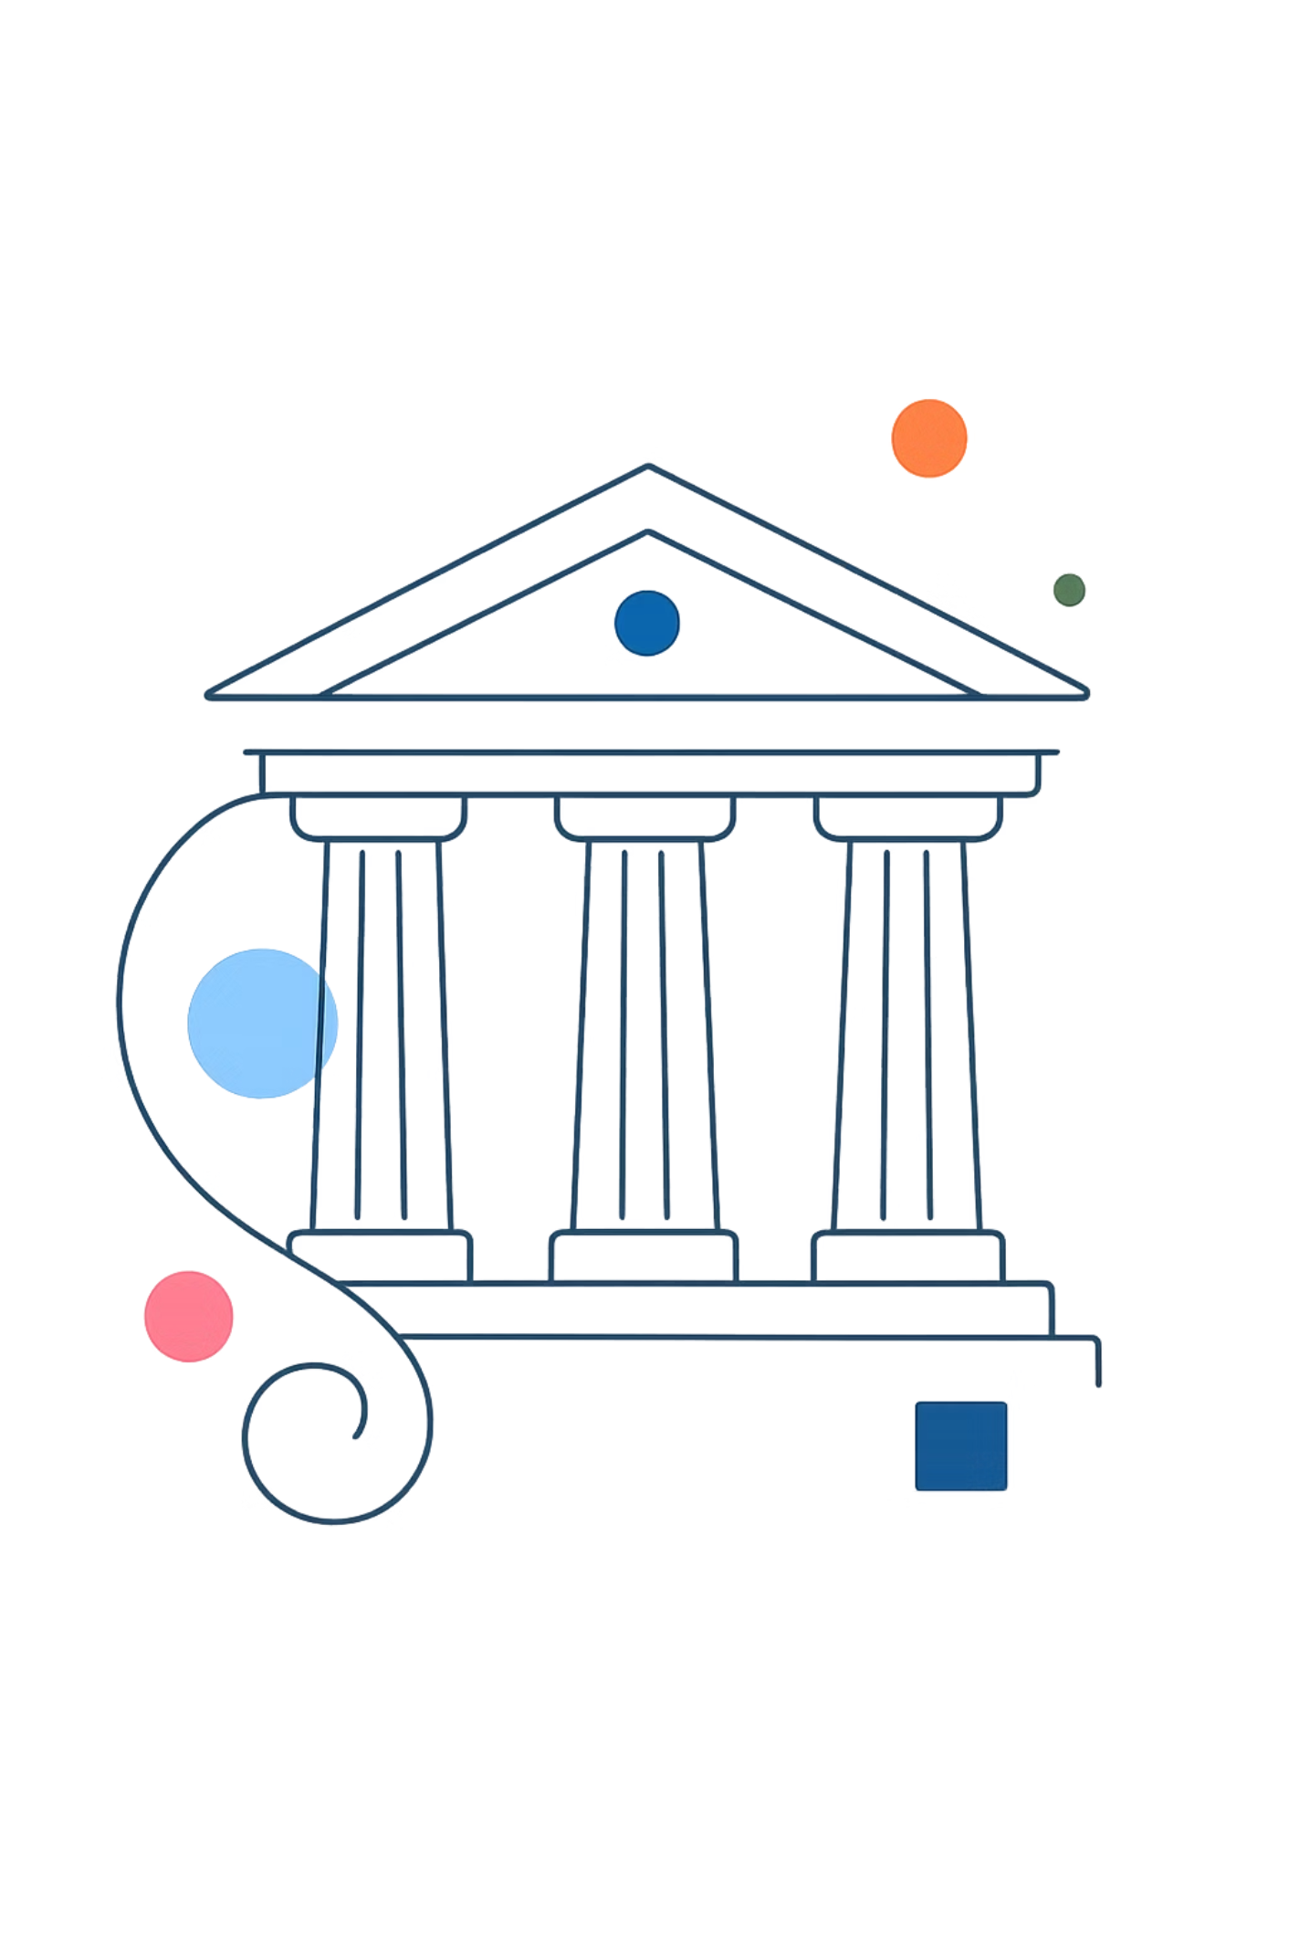
THE CENTRAL ARGUMENT
Cash is not just a payment method.
Cash is a sovereign monetary institution of general constitutional interest
Monetary
The apex retail tier in Mehrling's hierarchy — the only Tier-1 instrument that ordinary citizens can hold directly, without any institutional intermediary.
Behavioural
It disciplines spending through the pain-of-paying, anchors mental accounting, and shapes the psychology of ownership and financial responsibility.
Constitutional
It is the last form of money citizens can own as private property — without intermediation, without institutional permission, without surveillance.

Slide 4
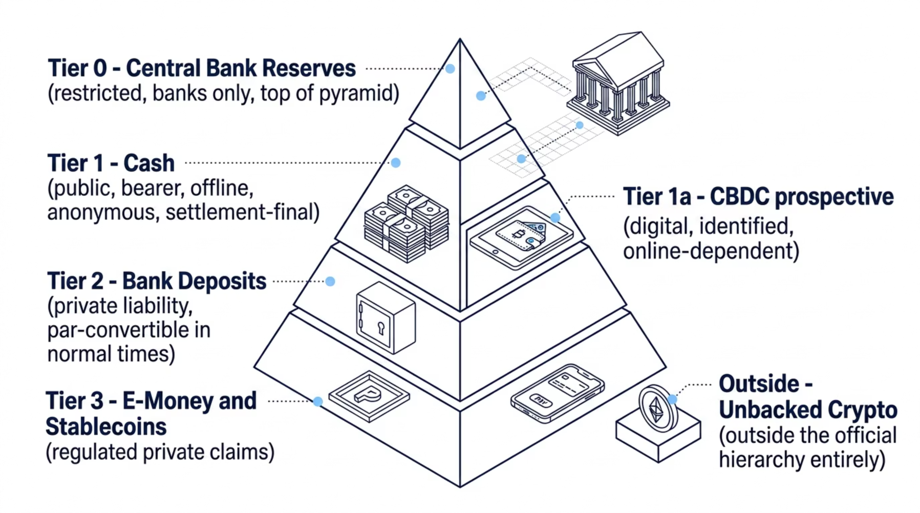


THE HIERARCHY OF MONEY
Where cash sits — and why no digital instrument can take its place
Cash is the apex retail instrument: the highest-tier money that ordinary citizens can hold directly. No digital alternative — not even a CBDC — currently occupies this position. A CBDC sits at Tier 1a: it shares the sovereign issuer, but not the physical, bearer, offline properties that define Tier 1.

Slide 5
FIVE CONSTITUTIVE PROPERTIES
All jointly necessary. None sufficient alone.
Bearer Transfer
1
Title passes by physical delivery. No identification, no record-keeping, no third party is required or involved.
Offline Independence
2
No telecoms, no power grid, no network connection required. Two parties and the currency itself suffice for a complete transaction.
Transactional Anonymity
3
No mandatory record of who paid whom, for what, or when. Privacy is not a side-effect — it is a structural, constitutive feature of the instrument.
Settlement Finality
4
Irrevocable, non-repudiable, and complete at the moment of delivery. Property transfers without any intermediation whatsoever.
Public Issuance
5
A direct liability of the monetary sovereign. The citizen's last unmediated claim on the state — requiring no institution to hold, use, or transfer.

Slide 6

OFFLINE INDEPENDENCE
What we learned from a real test
−41pp
The Lesson
ATM withdrawals in the affected regions fell 80% below normal — because the machines themselves had no power. Meanwhile, in unaffected islands, citizens rushed to withdraw cash as insurance against potential future outages.
Card Spending
vs April 2024 baseline — the immediate collapse of digital transactions
Offline payment capability is critical infrastructure. It must be maintained before the emergency, not rebuilt during it.
−54%
National e-Commerce
drop during the blackout period, as online infrastructure failed
−34%
Consumer Spending
overall drop — economic activity contracted sharply without working payments
+50%
ATM Withdrawals
in unaffected Canary and Balearic Islands — pure insurance demand, immediately observable
Source: ECB Economic Bulletin 6/2025 — Iberian blackout analysis

Slide 7
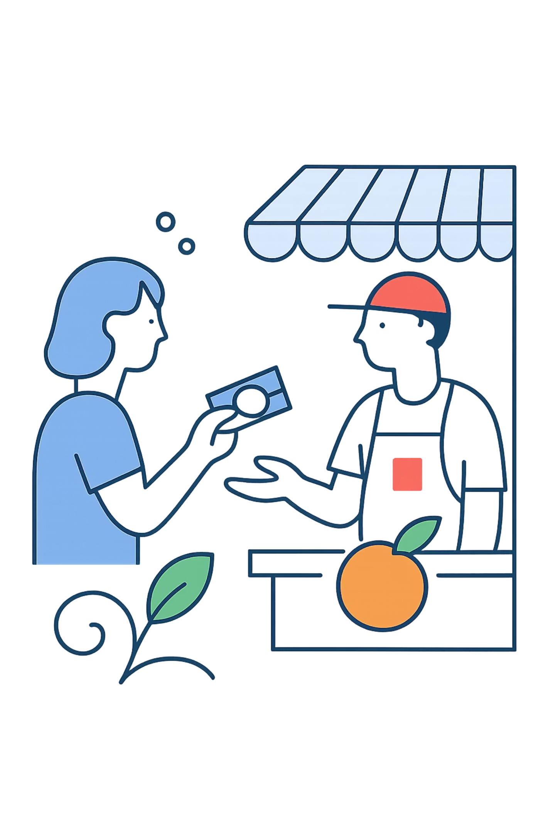

PRIVACY AS A PUBLIC GOOD
Every citizen who retains the option to pay in cash constrains the data-extraction capacity of commercial and governmental actors — benefiting even those who never use cash.
Garratt & van Oordt (2021), Journal of Political Economy
Cash — No Mandatory Record of:
Digital Payment — Permanent Record of:
Who paid, to whom, or for what
When, where, or how often
Any device, IP, or behavioural profile
Nothing monetisable by any party
Identity, location, and timestamp
Merchant, category, and amount
Device, IP address, and behavioural profile
All data monetisable indefinitely by multiple parties
For domestic abuse survivors, political dissidents, and undocumented migrants — anonymity is not a preference. It is a survival condition.

Slide 8
THE PROPERTY–PRIVACY NEXUS
Money you can own, not money you have an account in
Dimension
Cash
Digital / CBDC / Deposits
Form
Bearer instrument
Account entry
Holder relationship
Sovereign liability, directly held
Contractual claim against institution
Custody
You hold it; no one inspects it
Institutional custody at all times
Inspection threshold
Judicial order, with full due process
Administrative request; often no judge required
Effect of institutional failure
Unaffected — you hold the asset directly
Conditional; sometimes bailed-in (Cyprus 2013)
Warren & Brandeis (1890): "the right to privacy is grounded in the right of property." Cash is the last monetary instrument to which this nexus fully and unconditionally applies.

Slide 9
EURO BANKNOTES IN CIRCULATION
A sevenfold rise — through every shock, in every direction
2008
1
Global Financial Crisis — citizens fled to the only instrument that required no bank to function
2
2013
Cypriot Bail-In — depositors across the eurozone realised their accounts could be frozen or confiscated
2020
3
COVID-19 — +17% in circulation within 12 months, despite widespread restrictions on cash handling
4
2022
Russia Invades Ukraine — +6–10σ withdrawal spikes in Baltic states; existential threat triggers existential hoarding
2025
5
Iberian Blackout — +50% ATM withdrawals in unaffected zones: pure, rational, forward-looking insurance demand
Sources: ECB Annual Accounts; Ashworth & Goodhart (2020); Beckmann & Zamora-Pérez (2023); ECB Economic Bulletin 6/2025

Slide 10
THE PAIN OF PAYING
The form of payment is not neutral
2.0×
+22–54%
Insula
Debit vs Cash Bids
Neural Correlate of Pain
Willingness to Pay
Increase in spending across multiple categories in incentivised experimental settings with real money at stake.
Runnemark, Hedman & Xiao (2015)
Cash payments activate the brain's pain region — the insula — more strongly than card payments. Confirmed via fMRI.
Mazar, Amir & Ariely (2017)
Credit-card vs cash bidders for the same item in real auction settings. The mere presence of a card doubles bids.
Prelec & Simester (2001)
Frictionless digital payment is not a consumer benefit. It is the systematic, evidence-based degradation of financial self-control — designed into the payment infrastructure itself.

Slide 11
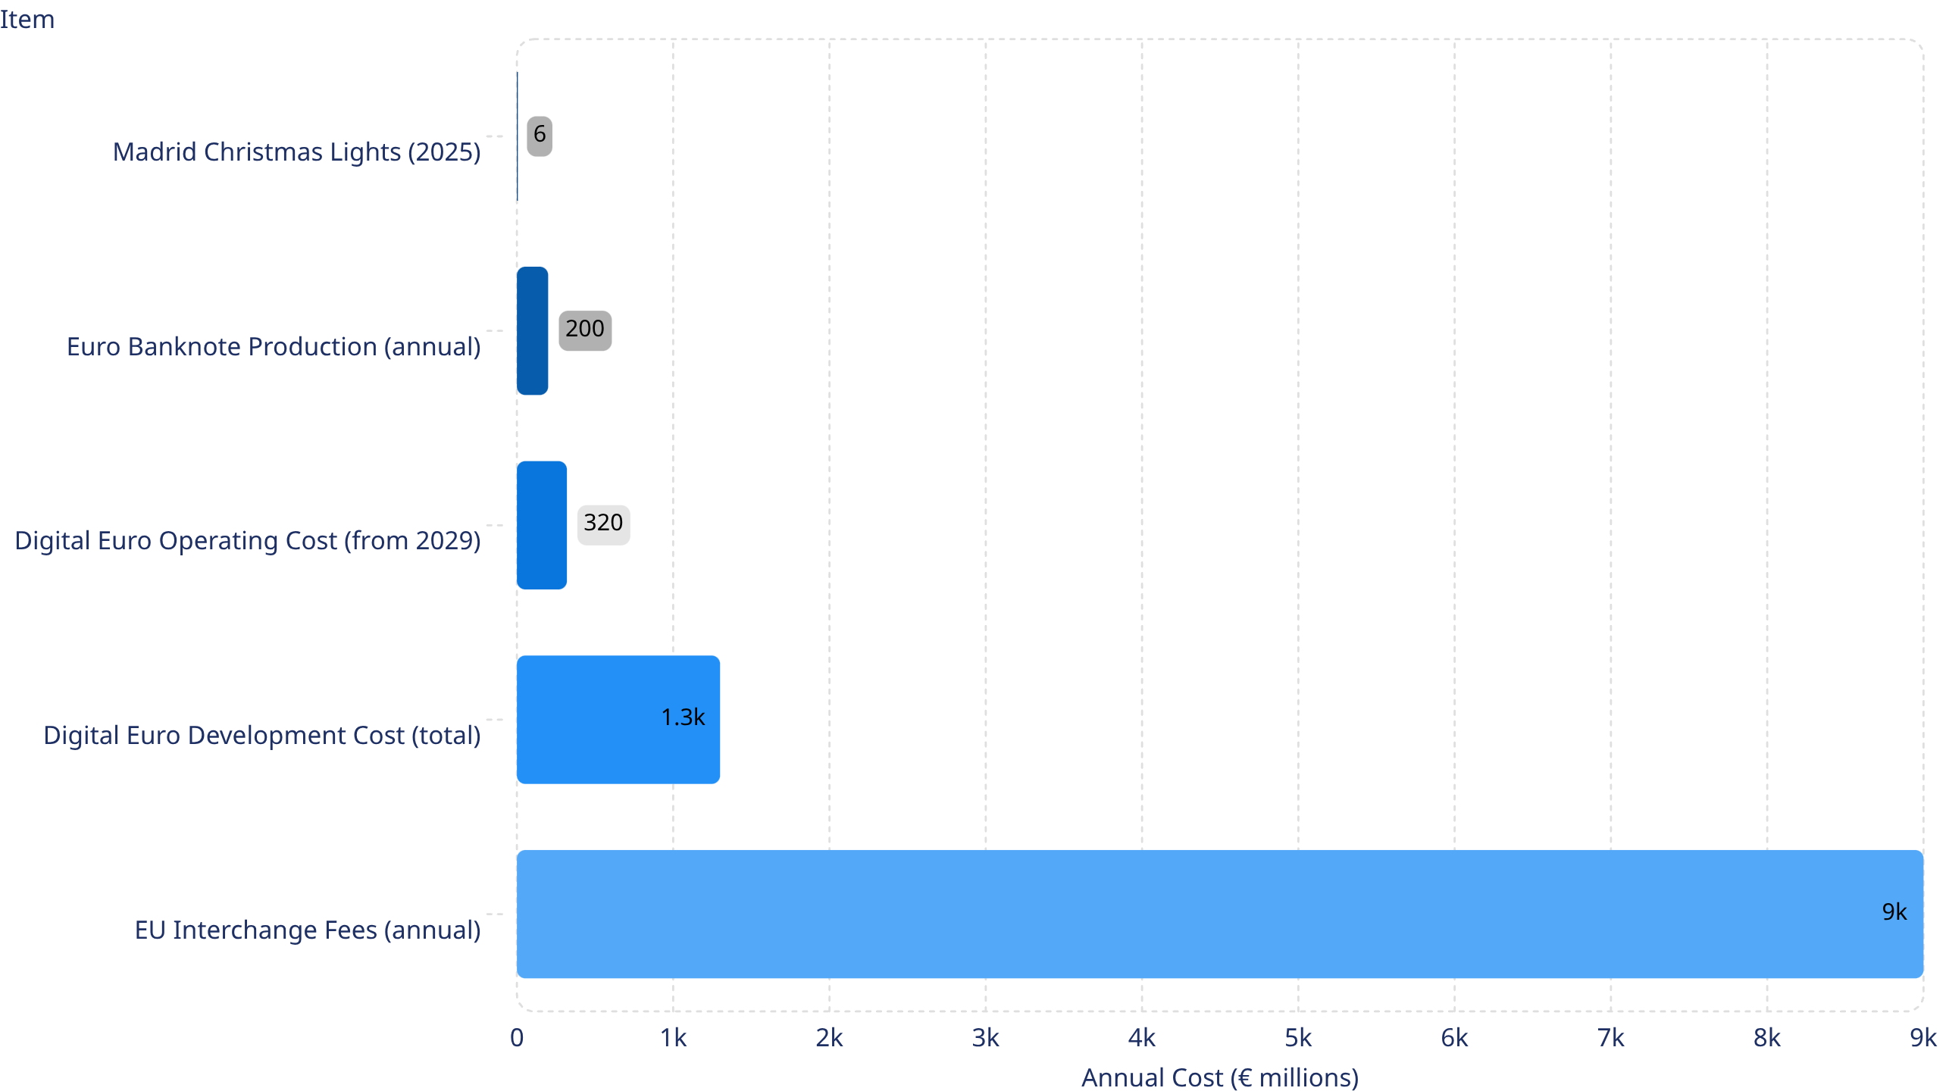
THE ECONOMICS OF WHAT WE FUND
A question of proportion
Card networks extract more from the EU economy every year than the digital euro will cost to build — and roughly 1,500 times more than what Madrid spends to look festive for six weeks. Sources: ECB; European Commission; Copenhagen Economics 2020; Madrid City Council 2025.

Slide 12

RESILIENCE IS PRICED IN — EXCEPT FOR CASH
Total-defence spending vs. the cost of keeping cash alive
EU 2025 Defence Spending
Annual Cost of Euro Cash Provision
€381bn
<€5bn
A year — and rising 11% annually. Defence is now treated as critical infrastructure. We rebuild the army before the war, not during it.
For the entire Eurosystem — printing, distribution, ATM network, central-bank handling combined. Less than 1.3% of defence spending.
The only payment instrument that survives every form of attack — kinetic, cyber, or infrastructural — costs a negligible fraction of what we spend on conventional defence.
Sources: EDA Defence Data 2024–2025; cost of euro cash provision estimated from Eurosystem reports and ECB-coordinated retail-payment cost studies (cash unit cost €0.42).

Slide 13
THE SILENT TAX
What happens to seigniorage when cash disappears
With Cash
Without Cash
Citizen pays merchant directly — no intermediary
Settlement is final and instant at point of delivery
Seigniorage flows to central bank, then to public treasury
Public revenue. No private toll.
Citizen pays via issuing bank
Routed through card network (Visa / Mastercard)
Processing fee extracted by acquiring bank
Remainder finally reaches the merchant
A toll at every single layer.
Eurosystem seigniorage from banknotes: several €bn per year flowing directly to national governments.
EU merchants paid ≈ €9bn/year in interchange and scheme fees in 2024 — a private tax levied on every transaction in the economy.
Rochet & Tirole (2002, 2003, 2006): when cash is no longer the outside option, card networks extract monopoly rents from the entire economy. The consumer pays through merchant surcharges; the merchant pays directly. Everyone loses except the network.

Slide 14
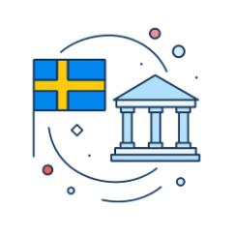
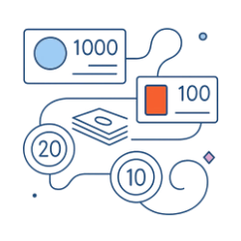


THE NORDIC PIVOT
From cashless champions to cash mandates
Sweden
Norway
Finland & Austria
Riksbank Act imposes a statutory duty to ensure payment infrastructure in peacetime crisis and heightened alert. Cash acceptance mandated at grocers and pharmacies from 1 July 2026. Recommended household reserve: 1,000 SEK per adult.
Right-to-pay-in-cash law enters into force with fines for businesses that refuse — in a country where cash's POS share had fallen to approximately 2%, the lowest in the world.
Cash integrated into national emergency preparedness frameworks. Austria's Nationalbank establishes a network of preparedness cash envelopes at post offices — approximately €100 per family member in small denominations.
This convergence across different political contexts, economic systems, and ideological traditions is not ideology. It is rational, evidence-based institutional response to observable and documented risk.

Slide 15
THE LONG ARC OF MONETARY POLITICS
Cash is the last remnant of a constitutional monetary order
16ᵗʰ Century — School of Salamanca
Vitoria, Azpilcueta, Soto: sovereign monetary power is bounded by justice. Debasement is expropriation. The first constitutional theory of money.
1870–1914 — Classical Gold Standard
Hard constitutional limit on monetary discretion. Cash is gold, or a direct and redeemable claim upon it.
1944 — Bretton Woods
Dollar–gold convertibility at the international tier; domestic monetary discretion begins to expand.
1971 — Nixon Shock
Gold convertibility suspended. The beginning of progressive, systematic monetary privatisation.
1980s–90s — Financial Deregulation
Money-market funds, securitisation, derivatives. Private near-money explodes in volume and complexity.
2020s — The Cashless Campaign
The final step: elimination of the last public monetary instrument, framed as technological inevitability rather than political choice.
The 'death of cash' is not technologically neutral. It is the culmination of a decades-long project of monetary depoliticisation.

Slide 16
CAN A CBDC REPLACE CASH?
Mapping the five constitutive properties onto each instrument
Property
Cash
Digital Euro
Key Distinction
Bearer Transfer
✅
❌
Title passes by delivery; no account required. CBDC requires wallet and identity.
Offline Independence
✅
⚠️ Partial
ECB design allows limited offline for small values only. Full offline not achievable.
Transactional Anonymity
✅
❌
All CBDC transactions recorded; data minimised, not eliminated. Structural difference.
Settlement Finality
✅
✅
Both settle on central-bank money. This property is genuinely shared.
Public Issuance
✅
✅
Both are direct ECB liabilities. Issuance is genuinely shared.
A library card is not a substitute for a book. The digital euro is a valuable and welcome innovation — but it is not, and cannot be, a substitute for cash. Three of the five constitutive properties cannot be replicated in digital form.

Slide 17
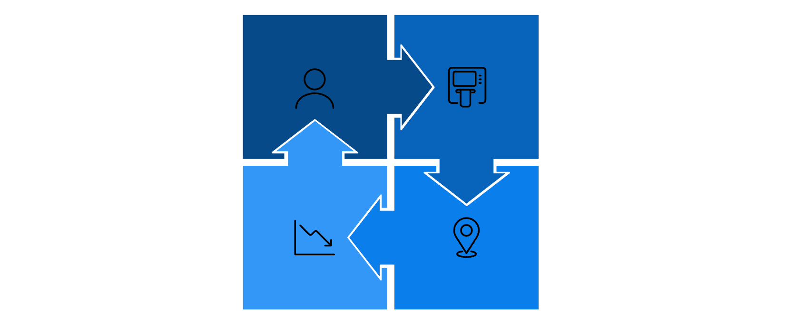

THE TIPPING POINT
Why delay is not neutral
The Cash Doom Loop
The Cost Spiral
5×
Fewer users
Fewer profitable ATMs
estimated cost per withdrawal in 15 years if current decline trends continue unchecked
Accelerating network contraction
Less convenient cash access
"Once cash infrastructure has gone, rebuilding it is very hard."
— UK Access to Cash Review, 2019
Once the feedback loop takes hold, each stage reinforces the next. The system collapses not through a single decision, but through accumulated neglect.
Infrastructure decisions made today determine options available during the next crisis. There is no neutral choice — inaction is itself a decision with irreversible consequences.

Slide 18
CONCLUSION
The question is not whether we can afford to maintain cash.
It is whether we can afford to lose the last form of money that belongs, without qualification,
to the citizens — not to the institutions.
Thank you.
franrod@ugr.es
ESTA · Berlin · 8 June 2026

