Slide 1
Rural Sweden

Slide 4
Tryggad tillgång till kontanter
Delbetänkande av Riksbankskommittén
Stockholm 2018
SOU 2018:42
In this interim report, the The Committee proposes that certain banks be required to provide reasonable access to cash services throughout Sweden.

Slide 5
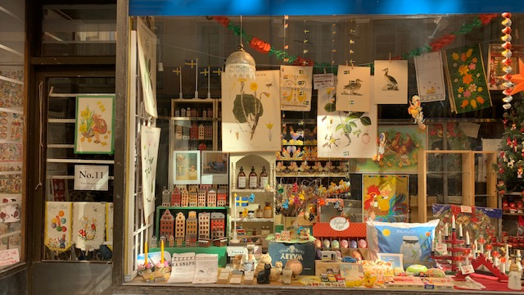

Slide 7
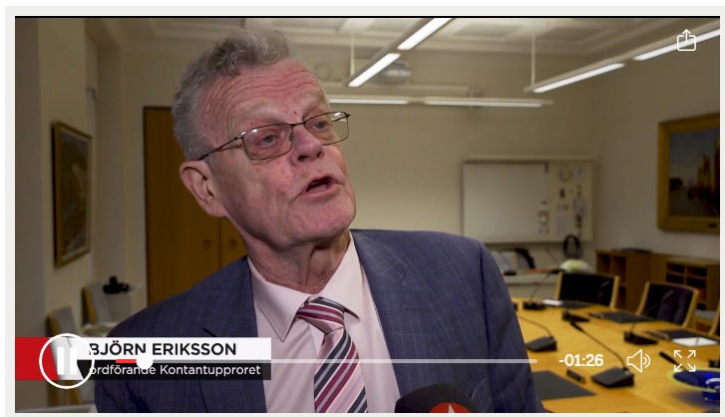

Slide 8
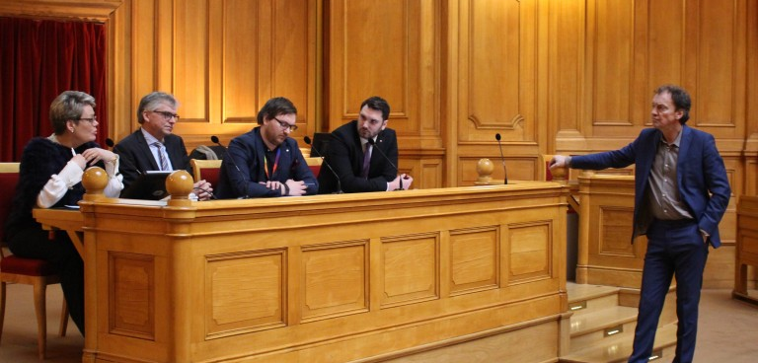

Slide 10
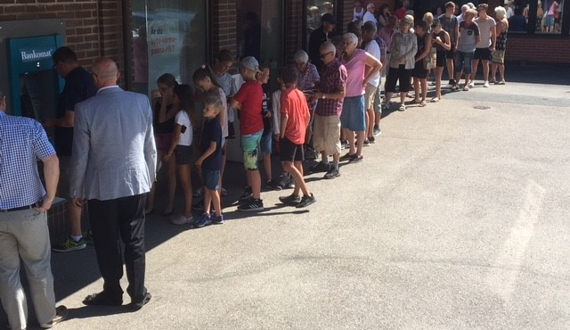

Slide 11
