Slide 1
Has the point of no return been reached in Sweden?
Peter Wesenberg
Nokas Group

Slide 2
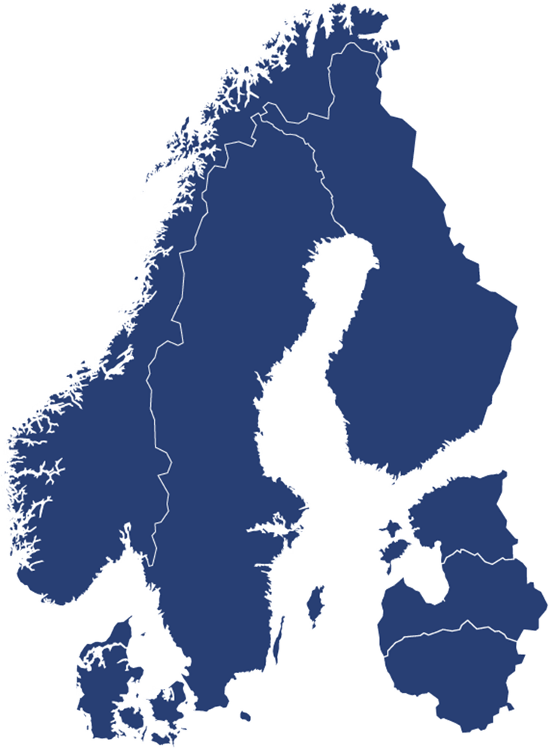
Nokas Group in brief
Multi service Security company in the Nordics
Established in 1987
Completed more than 80 aquisitions
2019 (run rate) gross turnover of MEUR 800
Cash handling services in Norway, Sweden, Finland and Denmark
Shareholders: Strong financial shareholders and management of Nokas
2
Notes:
2

Slide 3
Nokas organisation
Finance
IT
Adm
Sales*
Security
System
Cash
Handling

Slide 4
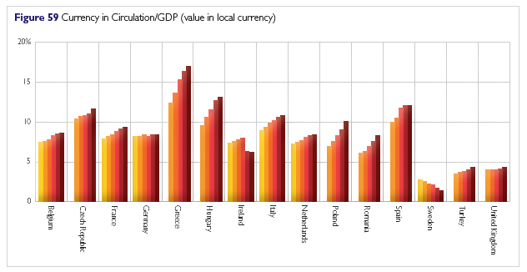
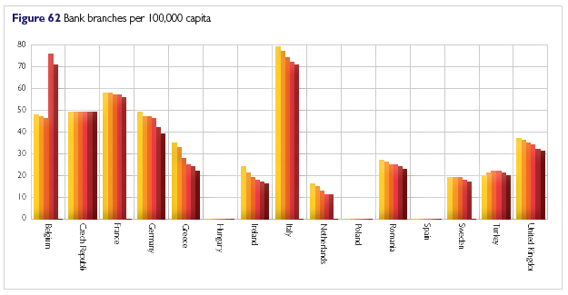
Cash is growing on a global basis. Cash use and handling in society will change. The Nordic countries are leading the way
Cash remains the most widely used payment instrument in the world and on all continents
National banks and increasingly also commercial banks are withdrawing from operational participation in the cash cycle, leaving these activities more and more to specialized 3rd parties
Currency in Circulation (CiC) has increased by an average of 39.5% in local currency value across selected European countries in recent years (7.9% per annum). One notable exception is Sweden, which reported a decline in the absolute value of Currency in Circulation (local currency) of 34.9% over the past five years

Slide 5
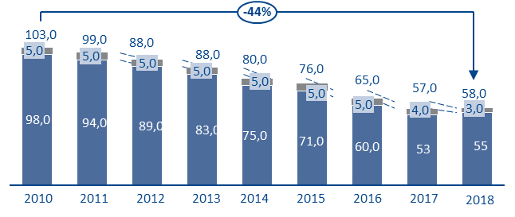
In Sweden cash volumes, # bank brances and ATMS per capita show a downward trend. Card payments per capita have increased by 35 per cent. Supply or demand driven?
Cash in circulation, SEK
Number of bank brances in Sweden 2010 – 2015
-12,6%
-7,3%
2010
2011
2012
2013
2014
2015
Number of ATMs per. 100 000 (adults) from 2010 – 2016
Averege card payments per capita 2010 – 2014
-19%
+35%
2010
2011
2012
2013
2014
2015
2016
2010
2011
2012
2013
2014
Kilde: ECB, Svenska Riksbanken

Slide 6
Cash volumes are growing in Denmark and the Eurozone*, strong reductions in Sweden and marginal reduction in Norway.
Coins
Notes
Denmark, DKK
Norway, NOK
-13%
+15%
50,4
50,3
51,2
49,8
49,2
49,9
49,0
46,9
65,1
65,8
66,8
69,8
70,3
70,5
70,8
4,8
4,9
4,8
4,3
4,3
4,5
4,6
4,5
43,9
61,8
61,7
5,6
5,9
5,7
5,8
5,9
6,0
6,1
4,5
5,7
5,6
45,7
45,5
46,4
45,5
44,9
45,4
44,4
42,4
39,4
56,1
56,1
59,5
60,1
61,1
64,0
64,4
64,5
64,7
2010
2011
2012
2013
2014
2015
2016
2017
2018
2010
2011
2012
2013
2014
2015
2016
2017
2018
Sweden, SEK
EUROZONE
-44%
+34%
103,0
99,0
88,0
1.041,5
1.109,4
1.153,1
5,0
5,0
5,0
88,0
80,0
911,7
936,3
980,4
25,0
26,0
26,9
5,0
5,0
76,0
65,0
862,0
23,1
23,7
24,2
5,0
57,0
58,0
22,3
98,0
5,0
4,0
3,0
1.083,4
1.126,2
94,0
89,0
83,0
75,0
839,7
888,6
912,6
956,2
1.016,5
71,0
60,0
53
55
2010
2011
2012
2013
2014
2015
2016
2017
2018
2010
2011
2012
2013
2015
2015
2016
* Not adjusted for growth in Euro countries
Kilde: ECB, Norges Bank, Danmarks Nationalbank, Svenska Riksbanken.

Slide 7
Cash Centre model in Sweden – how banks transfer their cost to retail.
Inflow
Counting
Sorting
Crediting customers
Debeting depot
Bank Depot
Storage of physical cash
Cash in the banks balance sheet
Operated by Nokas
Nokas pays for deposits/ withdrawals and charges customers
Outflow
ATM cassetts
Change money
Debeting customers
Crediting depot
Fee
Fee

Slide 8
Challenges going forward (1)
The banks have closed infrastructure, making cash unavailable in large parts of the country.
The banks are in the driving seat influencing the cost of cash for retailers (depot model).
Many retailers have stopped accepting cash payments because of cost and since cash is not a mandatory means of payment. The authorities do not seem willing to adress this issue.
The CM companies are reducing infrastructure with considerable speed to match demand and maintain profitability.
Nevertheless, the unit fixed cost is increasing, threatening profitmargins going forward
With a waning infrastructure and rising cost of cash, the banks must be laughing all the way to the……….

Slide 9
Challenges (2)
A survey (Sifo: 2019) shows that 72 per cent of Swedes want to be able to pay with cash in the future. This is an increase from 68 per cent in 2018. The share of Swedes who want a cashless society has decreased from 25 to 21 per cent since 2018.
The Swedish authorities are now adressing the need for cash as a contingency……too late!
Lesson: Do not let commercial banks take charge of the whole national infrastrucure for cash handling!

Slide 10
Two interdependant pillars necessary to preserve cash as a means of payment
Cash must be a mandatory means of payment to secure consumers freedom of choice
Banks must maintain available infrastrucure for cash in/cash out
Legislation
Enforcement

Slide 11
Thank you for your attention!

