Slide 1
Cashless: help or hindrance to anti-money laundering policies and Financial Intelligence Units?
Philippe de Koster, Director CTIF-CFI, Advocate General at the Supreme Court

Slide 2
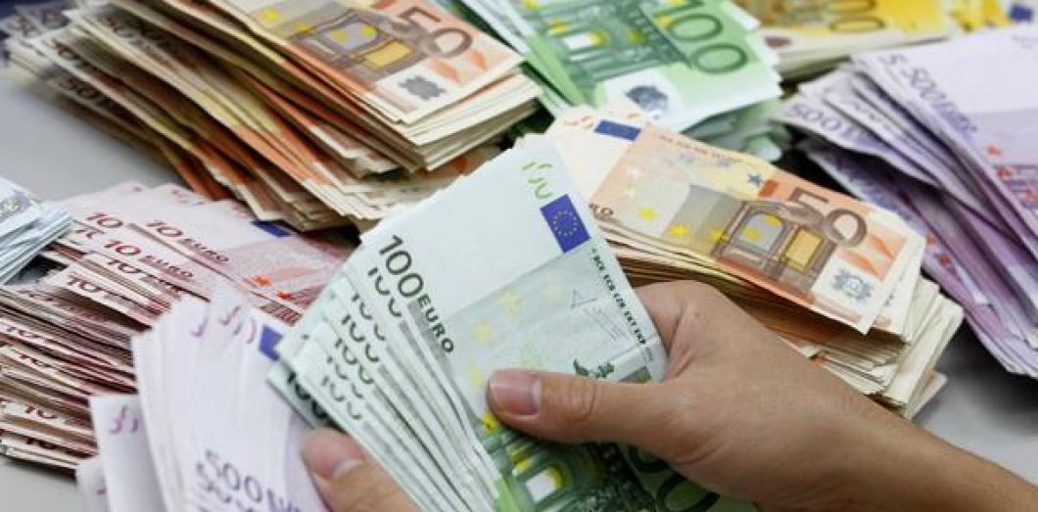
Cash is mainly generated AND USED
IN criminal activities such as
Drug trafficking
Trafficking in second-hand or stolen cars
Smuggling weapons and cigarettes
Human trafficking
Trafficking in illegal labour
Misappropriation of corporate assets
Fiscal fraud
Fraud

Slide 3
CHALLENGES FOR FIs, FIUs and LEA IF CASHLESS
CASH is an easy indicator of suspicious financial ML activities
CASH is easier to intercept by customs when moved cross-border
Uses of alternative payment systems (HAWALA, PSPs, Virtual currencies) create new vulnerabilities and challenges for FIUs, LEAs
Remote access and multiple small wire (instant) transfers require adequate IT monitoring tools

Slide 4
CASH IS MAIN INDICATOR OF SUSPICIOUS ML FINANCIAL ACTIVITIES
Cash deposits
+ Cash withdrawals
+ Money Remittance in
+ Money Remittance out
=
52 %
of all transactions in 2018 files sent by CTIF-CFI to LEA

Slide 5
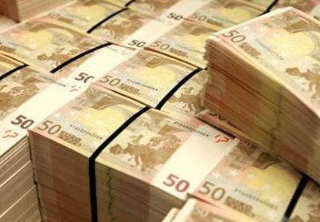
CASH ALSO LARGELY REMAINS UNDERGROUND
- Hawala
- Swap cash/goods
- Financial settlements
Criminals go underground because of FI’s de-risking strategies?
Underground transactions = transactions less perceptible for FIUs and LEAs

Slide 6
HAWALA
Used in many countries and/or local communities
Easiest way to move money in countries with poor financial systems
Still an unknown or underrated phenomenon
Transactions not fully undetectable (when cash is moved by couriers or the financial system is used to settle in and out transactions)
➔HAWALADARS are not “reporting entities”
➔No FIU access to data (STRs) from HAWALADARS

Slide 7
CHALLENGES
Some HAWALADARs ready to cooperate with AML/CFT Authorities to avoid being involved in ML/TF activities
HAWALADARs = Legal or illegal financial operators?
Licensing + Supervision of HAWALADARs?
HAWALADAR = a real AML/CFT partner or a black box?

Slide 8
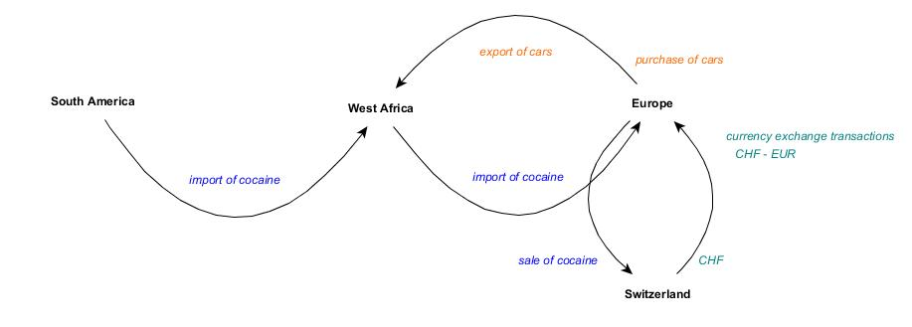
SWAP CASH / GOODS
- Drugs moved illegally from South America to West Africa
- Then from Africa to Europe, the drugs are sold in Switzerland
- CHF is exchanged into EUR in exchange offices
- EUR used to buy second-hand cars
- Cars exported and sold in Africa in cash

Slide 9
CHALLENGES
No cross-border transportation of cash (second-hand cars exported legally to Africa as substitute of cash), No risks of being intercepted with the cash when crossing borders
Need to increase Customs awareness
Increase capacity of Customs to identify smuggling of goods linked to cross border transportation of cash and illegal criminal activities
Better information sharing between Customs, Law enforcement, FIUs

Slide 10
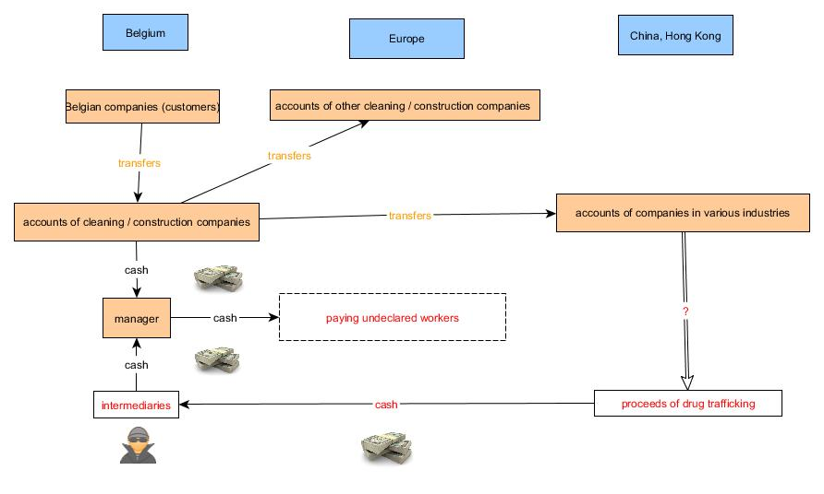
FINANCIAL SETTLEMENTS
- Construction or cleaning companies using illegal workers and acting as subcontractors received wire transfers from well-known construction or cleaning companies;
- Part of the funds was withdrawn in cash to pay illegal workers;
- The rest of the cash was received from drug traffickers in exchange for wire transfers to China and Hong Kong and was also used to pay illegal workers;
LEA information: drug traffickers/organisation move large quantities of cash in cars through Europe and in Belgium intermediaries hand over the cash to the construction or cleaning companies in exchange for wire transfers to China and Hong Kong (multiple beneficiaries)
WHAT HAPPENED TO THE FUNDS IN CHINA AND HONG KONG?

Slide 11
CHALLENGES
- No more cash entering or leaving the financial system. Detection is easier when cash is used in the financial system.
- Financial settlements take place informally: Financial institutions, FIUs and law enforcement have no view on what happens informally.
- Only useful indicator for financial institutions: wire transfers do not correspond to the official/declared activities of the company in Belgium (why is a construction or a cleaning company transferring money to China and Hong Kong?)

Slide 12
CASH IS FOR CUSTOMS AN INDICATOR OF POTENTIAL ML ACTIVITIES
HAWALA, Swap Cash/Good, Financial settlements ➔(cross-border) movements of cash
Regulation (EU) 2018/1672 on controls on cash entering or leaving the Union and repealing Regulation (EC) No 1889/2005
- One single EU territory creates opportunities for criminals moving the proceeds of crime (no more border controls inside the EU on cash)
- Poor or absence of cooperation between EU customs authorities (open door for criminals moving cash to or from multiple EU countries)

Slide 13
CASHLESS = CRIMINALS USE OTHER PAYMENT SYSTEMS
New PSP operators
Instant payments
Darknet
Virtual assets & virtual currencies (Bitcoin, Monero,…)
Blockchain technology

Slide 14
New PSP operators
New types of financial operators (GAFA)
New conducts in carrying on financial transactions (remote access versus face-to-face business relations, instant financial transactions, …)
Higher competition between new (and traditional) financial operators
Impact on AML/CFT compliance?
Cost of AML/CFT compliance becomes an issue?
New ML/TF vulnerabilities?
New challenges?

Slide 15
INSTANT PAYMENTS
Increasing competition between new and traditional financial operators
Instant payments also in FIs
New challenges for AML/CFT compliance, for FIUs and LEAs
Second line financial transactions monitoring versus first line with CASH
Post-monitoring of suspicious financial transactions
Freezing transactions and recovering assets = new challenges for FIUs and LEAs

Slide 16
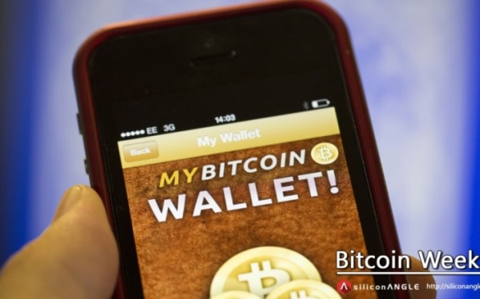
DARKNET, VIRTUAL ASSETS & VIRTUAL CURRENCIES
- Child pornography (80%) but also drugs, weapons …
- Crypto markets (Darknet eBay)
- Anonymity of users (TOR technology)
Anonymity of communications (TOR mail or TOR Hidden Service)
Anonymity of Payment (Cryptocurrencies)
- Darknet = full anonymity

Slide 17
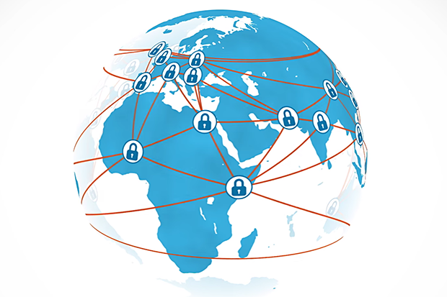
BLOCKCHAIN TECHNOLOGY
- New technology (decentralized ledger of encrypted transactions)
- Technology of Blockchain is developing very rapidly
- No central databases of transactions
- No central bank (virtual currency vs traditional banking system)
A Future largely underestimated?

Slide 18
HINDRANCE TO AML/CFT POLICIES AND FINANCIAL INTELLIGENCE UNITS AND LAW ENFORCEMENT INVESTIGATIONS ?
No cash indicator anymore
Reliance on second line monitoring and IT software (KYC & KYT)
Instant payments = new opportunities for criminals rapidly moving their funds/assets from one bank account to another
Instant payments = new challenges for FIUs and LEAs (tracing suspicious financial transactions becomes more difficult with instant payments)
More difficult to seize or freeze criminal assets
More difficult to seize virtual assets or virtual currencies

Slide 19
Cellule de Traitement des Informations Financières
Avenue de la Toison d'Or 55 boîte 1
1060 Bruxelles
Phone: +32 2 533 72 11
Email : info@ctif-cfi.be
www.ctif-cfi.be

