Slide 1
Securing the public´s access to cash services in a rapidly transforming payment market – the case of Sweden Ragnar Olofsson – Secretary in the Committee of Inquiry on the Riksbank
Presentation at the ESTA Conference in Vienna May 20th 2019

Slide 3
The Parliamentary Committee of Inquiry on the Riksbank
12 members representing all parties in the Swedish parliament
Experts from the Central bank, relevant government agencies, ministries, universities etc.
Meetings with 30+ stakeholders: Loomis AB, Nokas AB, banks, interest groups (retail, pensioners, consumers, etc.)
The Committee unanimously supported the proposals in the interim report from June 2018.
Notes:
The committe shall publish its final report 30th of November. A new law on the Riksbank. Very broad
The topic of access to cash and cash management has been treated with priority because there is some urgency in the current developments.
Report published in June 2018. Out for referral until October 2018. Now the Government is preparing to put forward a Bill before the summer.

Slide 4
The Committee´s proposals in short
Legal requirements on large banks (deposits from general public > SEK 70 billions) and offering payment accounts to provide reasonable access to cash withdrawals and deposits throughout Sweden
The central government shall intensify its current measures to support cash withdrawals and deposits
The Riksbank’s role in cash management, especially regarding cash depots, shall be clarified and strengthened.

Slide 5
Cash in circulation in Sweden

Slide 6
Development of cash services in Sweden
Number of bank branches providing cash services dropped by 55 per cent 2011—2016.
Number of ATM withdrawals and withdrawn amount has dropped by 50 per cent 2006—2016.
The share of cash payments in retail dropped from around 40 per cent in 2010 to around 15 per cent in 2016. 25 per cent of retailers think they are cash free already in 2020. 50 per cent in 2025.
But….
29 per cent of the population state that they need cash in order to get by in society. 68 per cent want to keep cash as a means of payment.

Slide 7
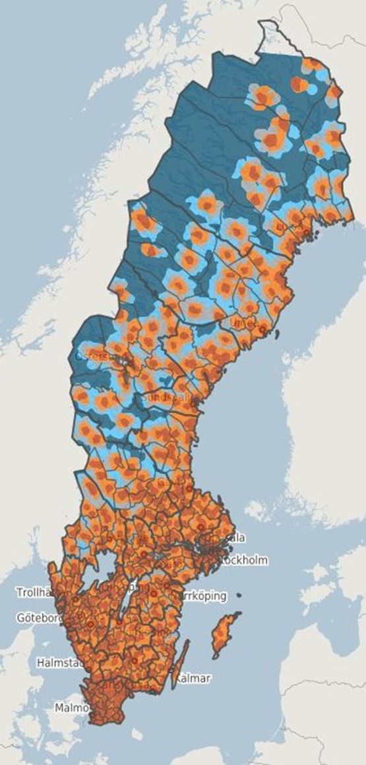
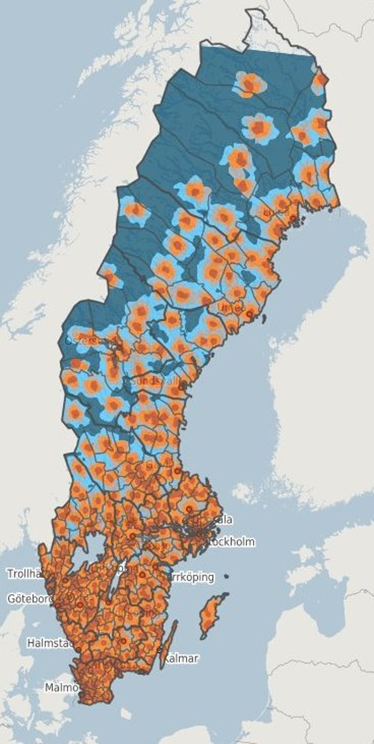
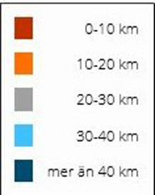
Access to cash services
Distance to locations for cash withdrawal
Distance to locations for
cash deposit
Källa: Pipos Serviceanalys (Tillväxtverket)
Notes:
Tydligt att det är Norrlands inland där det är längst avstånd till kontanttjänster. Men finns långa avstånd även i glesbygdsområden i Svealand och Götaland

Slide 8
The Committee’s starting points 1(2)
The development of access to cash services (cash withdrawals and deposits) should be controlled to ensure that the cash needs of the general public and society are met.
Enable government to determine democratically, and with sufficient information, the government’s role in the payment system and which means of payment should be available in the future, particularly regarding means of payment provided by the Riksbank.

Slide 9
Committee’s starting points 2(2)
Initiatives should primarily target rural areas, where there is greatest risk that cash-in transit and cash services will disappear completely.
Existing cash management infrastructure and access to cash services should be safeguarded for economic efficiency reasons. Cooperation on infrastructure and common solutions in the cash management chain should be encouraged.

Slide 10
Why requirements on larger banks?
Larger banks with national presence have a particular responsibility to provide access to cash services in society.
Banks’ central role in payment processing makes it unreasonable for banks to abdicate their responsibility to handle a certain means of payment as long as it is needed in society and is legal tender
All bank customers, including those that are in need of cash, must be able to use their payment accounts.

Slide 11
How to specify ”reasonable access”?
Maximum of 0.3 per cent of the population (30 000 persons) having to travel more than 25 kilometres by public roads to a location to make cash withdrawals. (deposits 1.22 per cent).
Reduction of the number of people by 15 percent compared to current situation.
Requirements on every individual bank (currently six). Strong incentives for the banks to cooperate to live up to the legal requirements.
Substantial sanctions for banks not meeting the requirements
Government agencies follow-up requirements annually through an existing database with all points for cash services road net and population

Slide 12
The role of the Riksbank?
Responsibility for effective cash management throughout the country – in the form of cash depots, cash processing and cash-in-transit services – is unclear. No agency is “in charge”.
Sweden’s model for cash management focuses primarily on efficiency and has been entrusted to the private market. Cash depots are currently a private monopoly in Sweden. The Riksbank one of most passive CBs
The Riksbank should be given overall responsibility for cash management in Sweden. The Riksbank’s specific responsibility for cash depot operations should be clarified in law and help safeguard access to cash services throughout Sweden.
Legal proposal in final report November 2019

Slide 13
Thank you for your attention!

Slide 14
Extra PP-slides

Slide 15
Consequences of the Committee’s proposals
The proposals benefit:
people and businesses in rural areas
certain elderly people,
newly arrived immigrants and
individuals with varying functional disabilities
the vulnerability of the cash management chain will be reduced as a result of the requirements,
The costs for the banks covered by the requirements concerning reasonable access are expected to increase by between SEK 8 and 15 million per year in total. Less room for additional savings on cash services in the future
Central government expenditure is expected to increase by SEK 9–10 million per year

