Slide 1
The Lessons from Sweden
LINK ATM Scheme
Graham Mott

Slide 2
Agenda
LINK’s background
Access to Cash Review
Why Sweden?
What did we find?
What does it mean for the UK?

Slide 3
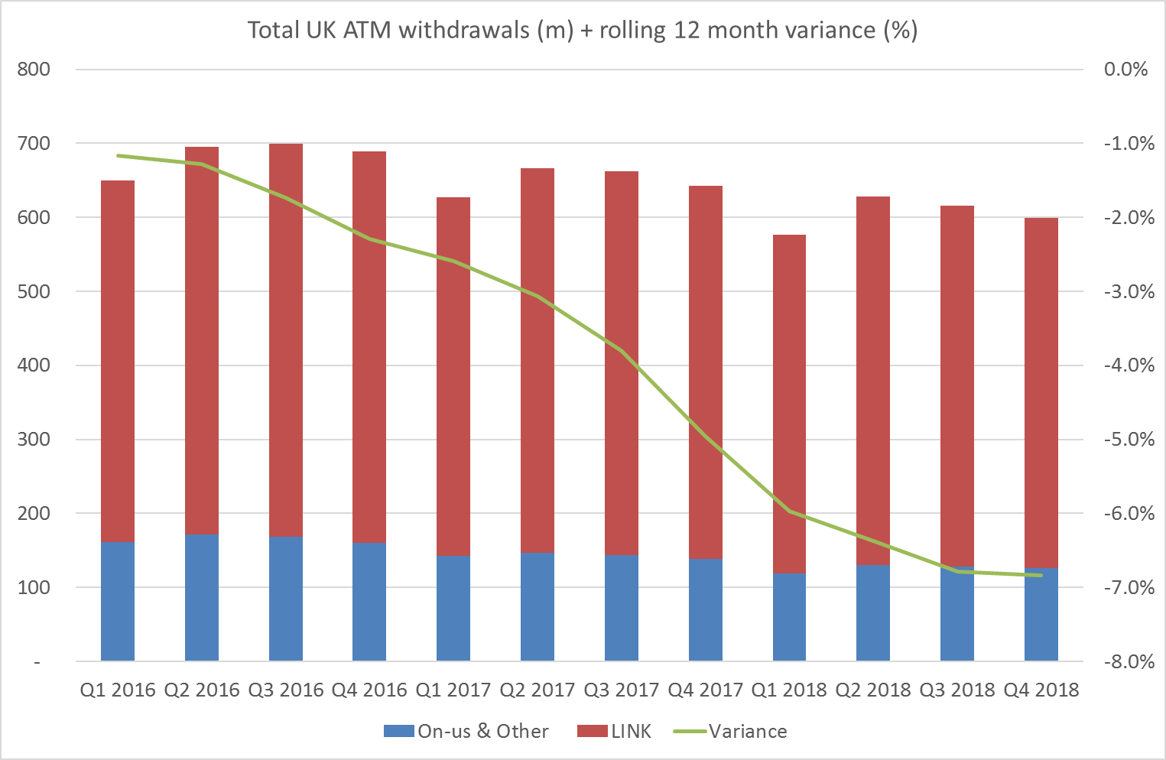
ATM total ATM withdrawals
Including on-us the UK is showing significant falls in ATM use

Slide 4
LINK ATM withdrawal volumes
Until mid 2017 reductions in branch balanced, to a certain degree by increases in remote ATMs. However LINK’s figures are showing big drops into 2019

Slide 5
The driver – cash payments in the UK
Forecasts by UKFinance show cash payments halving in the last 10 years and halving again in the next

Slide 6
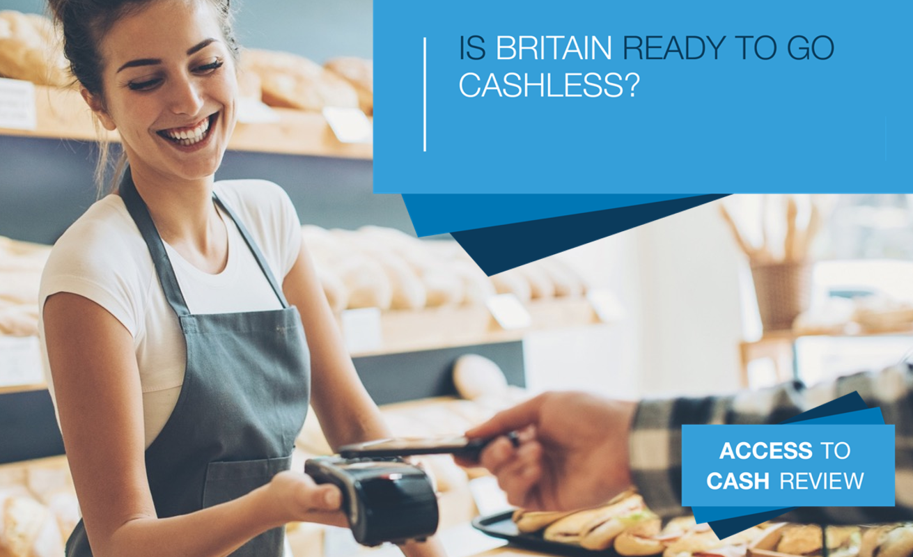
Independent Access to Cash Review
Chair Natalie Ceeney CBE
Eight member independent panel
Report in March 2019
www.accesstocash.org.uk

Slide 7
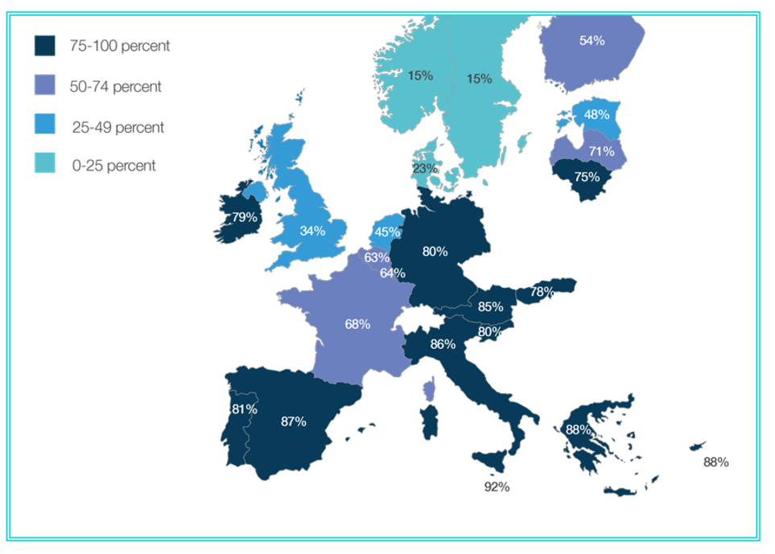
Share of cash payments carried out by households
Sweden is the obvious country to look at. Consistent “pin-up” for cashlessness

Slide 8
Study Tour of Sweden 2018
Kurt Gjesten - CEO Pan Nordic Cards Association
Niclas Arvidsson - Associate Professor Royal Institute of Technology
Jan Olsson - Head of National Fraud Centre
Bengt Nilervall - Head of Policy Svensk Handel – Retailer Association
Marie Nordgren -Head of Business Development Getswish
Ragnar Olofsson - Economic Adviser Parliamentary Inquiry on Cash Management
Rolf Carlsrom - Swedbank Bankomat ATM Network
Hannes Anagrius - Researcher, The Swedish Consumers’ Association
Erik Elowsson- Kontantupproret – Access to Cash Campaign
Jenny Lindroth - SituationStklm
Olof Bjuro - Head of Postal Affairs at the Communications Regulator
Fredrika Hed Rosén, Senior Adviser Communications Regulator
Cecilia Skingsley - Deputy Governor of the Riksbank
Gabriela Guibourg - Head of Analysis and Policy Payments Riksbank
Leif Trogen - Head of Financial Infrastructure Swedish Bankers Association
Henrik Bergman – Deputy Director Financial Infrastructure
Access to Cash Review
Natalie Ceeney CBE Chair
Graham Mott LINK
John Howells LINK
Richard Koch Access to Cash Review
David Hensley Access to Cash Panel
James Daley Access to Cash Panel
Louise Buckley PSR
David Geale FCA
Jonathan Davidson FCA

Slide 9
Sweden is on the way to a cashless society.
The demand for banknotes is declining rapidly, around 50% since 2012.
Card transactions are growing by 10%, ATM withdrawals are declining by 10% year on year and a new payment product Swish is being used by 65% of the population, just 6 years after launch with volumes growing by 10% per month.
In common with its Nordic neighbours Swedes are typically digitally engaged, embrace new technology and are generally trusting of government, the banks and appear to have a lack of concern about privacy, regulation and government solutions.
The population is relatively highly-educated and IT-literate.
On the current trajectory and without intervention, Sweden could become a cashless society within 5 years.

Slide 10
Access to cash is now a considerable problem for certain consumers.
There are still several groups in society that are still largely dependent on cash and would be disadvantaged if it were to disappear.
Some of the older generation have difficulty accessing technology, consumers with cognitive disabilities, newly arrived immigrants and those in rural areas are particularly dependant on cash.
Research indicates that 22% of people with disabilities do not have the means to digitally identify themselves or authenticate a transactions. Registering for services is particularly difficult for this group.
A number of small retailers also have business models which are cash dependant. Around 5% of the population have limited access to the internet or mobile services.
It was suggested that 10% of the population is in danger of being left behind.

Slide 11
The cash supply chain is at breaking point
Banks have reduced the number of bank branches and are making about half of them cashless.
ATMs are becoming unprofitable and few are available in sparsely populated areas meaning that customers require to travel long distances to access cash services.
In cases in which the market’s services are insufficient, the Swedish Post and Telecom Authority (PTS) and county administrative boards have been assigned with responsibility for ensuring access to basic payment services.
The issue used to be confined to rural areas, but increasingly larger towns are without basic cash services.
PTS subsidises the provision of cash services through 35 convenience stores servicing around 30,000 citizens but is finding it increasing difficult to fulfil its mandate as retailers are reluctant to provide cash services.

Slide 12
Cash is seen as a potential contingency to card and online payments
There was significant concern over the resilience of digital payments and doubts over cash’s ability to act as a contingency.
The concern was not only errors and systems failures, the like of which we have seen in the UK, but also disruption from deliberate attacks on the national infrastructure from foreign powers and alike, something we have not seem raised in the UK.
Cash’s ability to act as a contingency was being considered, but there was concern there was simply not enough, that the reduced cash infrastructure would not be able to cope and also that the supporting cash infrastructure, such as ATMs, relied on the same underlying systems, such as power and might be similarly affected.

Slide 13
Civil Defence

Slide 14
Continued access to cash has become a politically charged issue.
There is cross party support for legal & regulatory intervention to arrest the decline in the availability of cash services.
The Riksdag has agreed that an effective cash infrastructure must not be allowed to disappear before Parliament is satisfied that no societal detriment will arise.
There is political consensus that the established banks have a responsibility to ensure the provision of core cash services, until such time as digital solutions are available to meet the demands of all citizens.
Measures are proposed that will ensure that no more than 0.3% of the population will be more than 25km from a facility to withdraw cash.
A similar measure is in place in relation to cash lodgement but the relevant target in this access is that the facility should be in a 25km radius of at least 98.8% of the population.
This proposal is not intended to indefinitely perpetuate the existence of cash.
The market is skeptical about this proposal.

Slide 15
Is there evidence that retailers are refusing to accept cash?
This is not a significant issue at present.
Although key retailers are piloting cash-free environments in limited stores and in some Swedish cities a number of retailers no longer accept cash, it is still accepted by 97% of retailers.
This is supported by the interview surveys carried out by the Riksbank, where 80% of respondents stated that they had only encountered shops not accepting cash less often than once a month.
However, a recent survey across the retail sector indicated that more than half of Swedish retailers will probably not accept cash after 2025.
This is on the basis that as volumes of cash sales falls many of the costs associated with a cash handling and management will increase the costs and inconvenience of continuing to accept it, particularly where there are fewer bank branches that will accept cash lodgements.
Growing issue in USA – not yet in UK

Slide 16
Retailers find cash more expensive than electronic payments
Any Retailer preference for cash is driven by the cost of cash acceptance relative to other payment mechanisms.
Many of the costs of accepting cash are fixed, which means that unit costs are increasing as cash payments decline.
In this market the data indicates that the cost of debit card acceptance is lower than cash handling costs.
Speed at the counter is a key factor
Consumers don’t want change – especially coin
In UK no 20p or £2 coins minted in 2017

Slide 17
Collaboration between banks has been a key factor in reducing the overall costs of access to cash and deployment of payment innovation.
The five major commercial banks transferred their ATMs to their joint venture Bankomat in 2013.
This has been successful in minimising costs of providing sustainable access to cash for consumers. It provides a mechanism to ensure continuing placement of ATMs in areas of low footfall, allows cross-subsidisation of unprofitable ATMs and cost saving in what is essentially a cost-driven rather than revenue generating business.
Collaboration has also been the key to a successful launch of Swish, Bank ID and a faster payment settlement system.
Swish and Bankomat have been very effective in their respective fields there did not appear to be a wider FinTech movement looking to solve the inclusion issues.
An example was given of a government ‘challenge’ to look at these issues and they received no bidders.

Slide 18
The decline in cash poses fundamental questions for central banks.
It raises key questions as to what money is and what continuing role the central bank should play in its provision.
Historically, central banks have provided banknotes and coins use for payments ensuring a high level of confidence in it as a means of exchange and store of value. Progressively this role is being subsumed by private actors.
The risks are that a concentrated private payment market leads to reduced competition, vulnerability of payments systems to systemic or technical failure which might possibly erode trust in money itself.
The Riksbank, in common with other central banks is considering issuing the e‐krone, a central bank digital currency, complementing physical cash and allowing citizens direct access to central bank money.
E‐krona could offer a competitively neutral infrastructure which payment service providers can join if they wish to offer services to households and businesses.

Slide 19
What advice would Sweden offer the UK?
The universal view was that the issues resulting from rapid deceleration of cash usage had not been considered and debated early enough.
This meant that there were now a limited range of available options and it was uncertain whether or not these would be effective.
The measures being considered were largely tactical, to buy time so that a more strategic approach could be developed, where the future of cash was at a precipice.
There was applause for the UK approach of starting to explore similar issues at a much earlier point on the journey that Sweden had travelled.

Slide 20
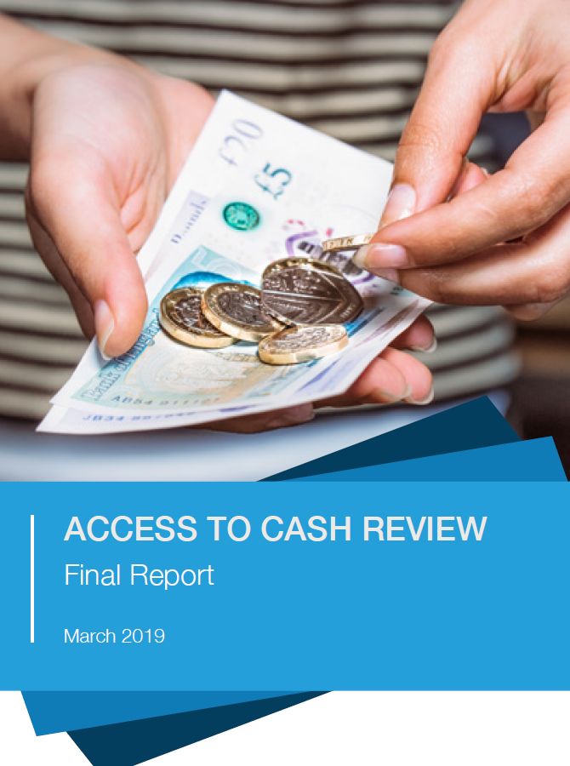
What has the UK done? – Access to Cash Report
Recommendation One: Guarantee access to cash.
A framework to incorporate other channels such as post office counters or cash from retailers’ tills. LINK is already speaking to consumer groups, its Members, other industry participants, regulators, and HM Treasury to help develop this guarantee.
Recommendations Two: Ensure cash remains widely accepted.
The cost of cash acceptance is a key element. Shared service centres being piloted. LINK keen to see innovation in this area, ie not to be limited to ATMs belonging to their own bank or building society.
Recommendation Three: Create a more efficient, effective and resilient wholesale cash infrastructure.
New working group announced by the Bank of England to ensure that the scale and structure of the cash infrastructure is as efficient and effective as possible.
Recommendation Four: Make digital payments an option for everyone.
HM Treasury has announced work in this area. Other regulators involved.
Recommendation Five: 5. Ensure joined-up oversight and regulation of cash.
Treasury has already announced a new Joint Authority Cash Strategy Group .

Slide 21
“What advice do I have for the UK? Look at your cash system now and be prepared to regulate, while you have time. When cash levels get too low, it will be too late to put back in place systems which have been dismantled’.
Cecilia Skingsley, Deputy Governor, Sveriges Riksbank
Sweden has today one of the most effective payment infrastructure in the world, in terms of cost, security and instant payments. Collaboration between banks in infrastructure solutions has been a key factor in the usage, development and deployment of payment innovation”
Rolf Carlström, Swedbank.

Slide 22
Thank you for all the help and support

